Slide 1

The Hidden Health Effects of Smoking
Done By Kawthar Isa

Slide 2

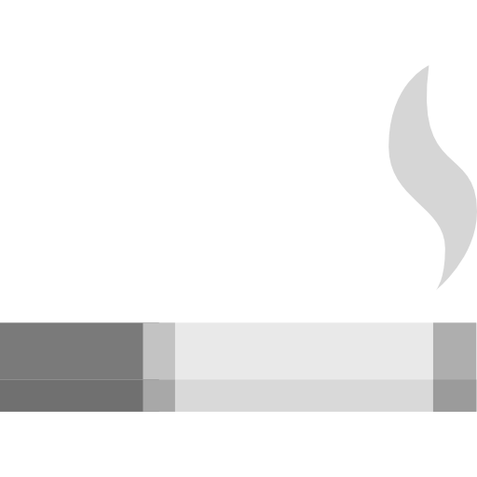
Problem Statement
Due to the heavy focus on the harmful effects of smoking on the lungs, the impact on other body systems has often been overlooked. This lack of attention creates a gap in understanding the full health risks of smoking.
To examine the role of smoking as a risk factor in the development and progression of major diseases.
To identify potential risk factors by examining patterns

Slide 3
Data Overview
20.46K
Number of Smoker
35.24K
Number of Non Smoker
4.20%
Female Smoker
11.38%
Smoker Over 60

Slide 4

Metabolic Syndrome
There is a 10% risk for smokers to develop metabolic syndrome

Slide 5

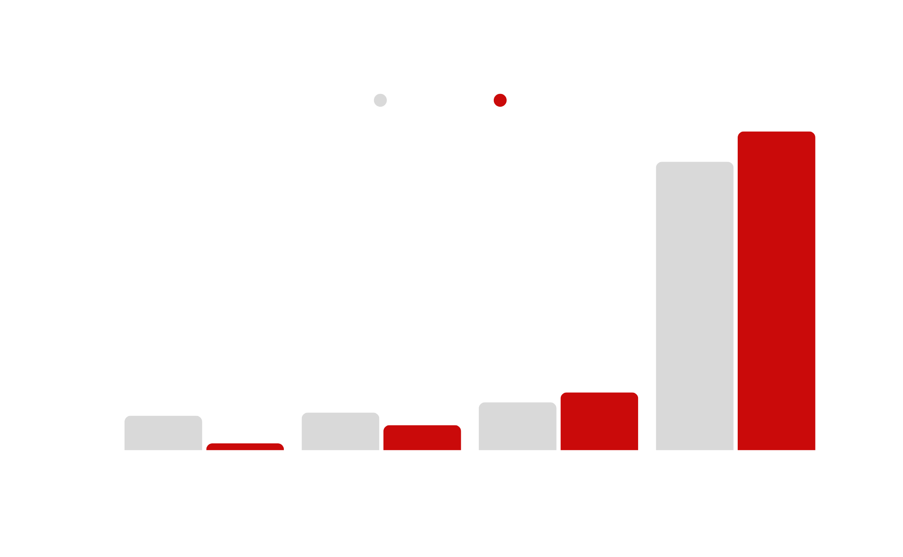
Body Mass
Smoker %
BMI Category

Slide 6
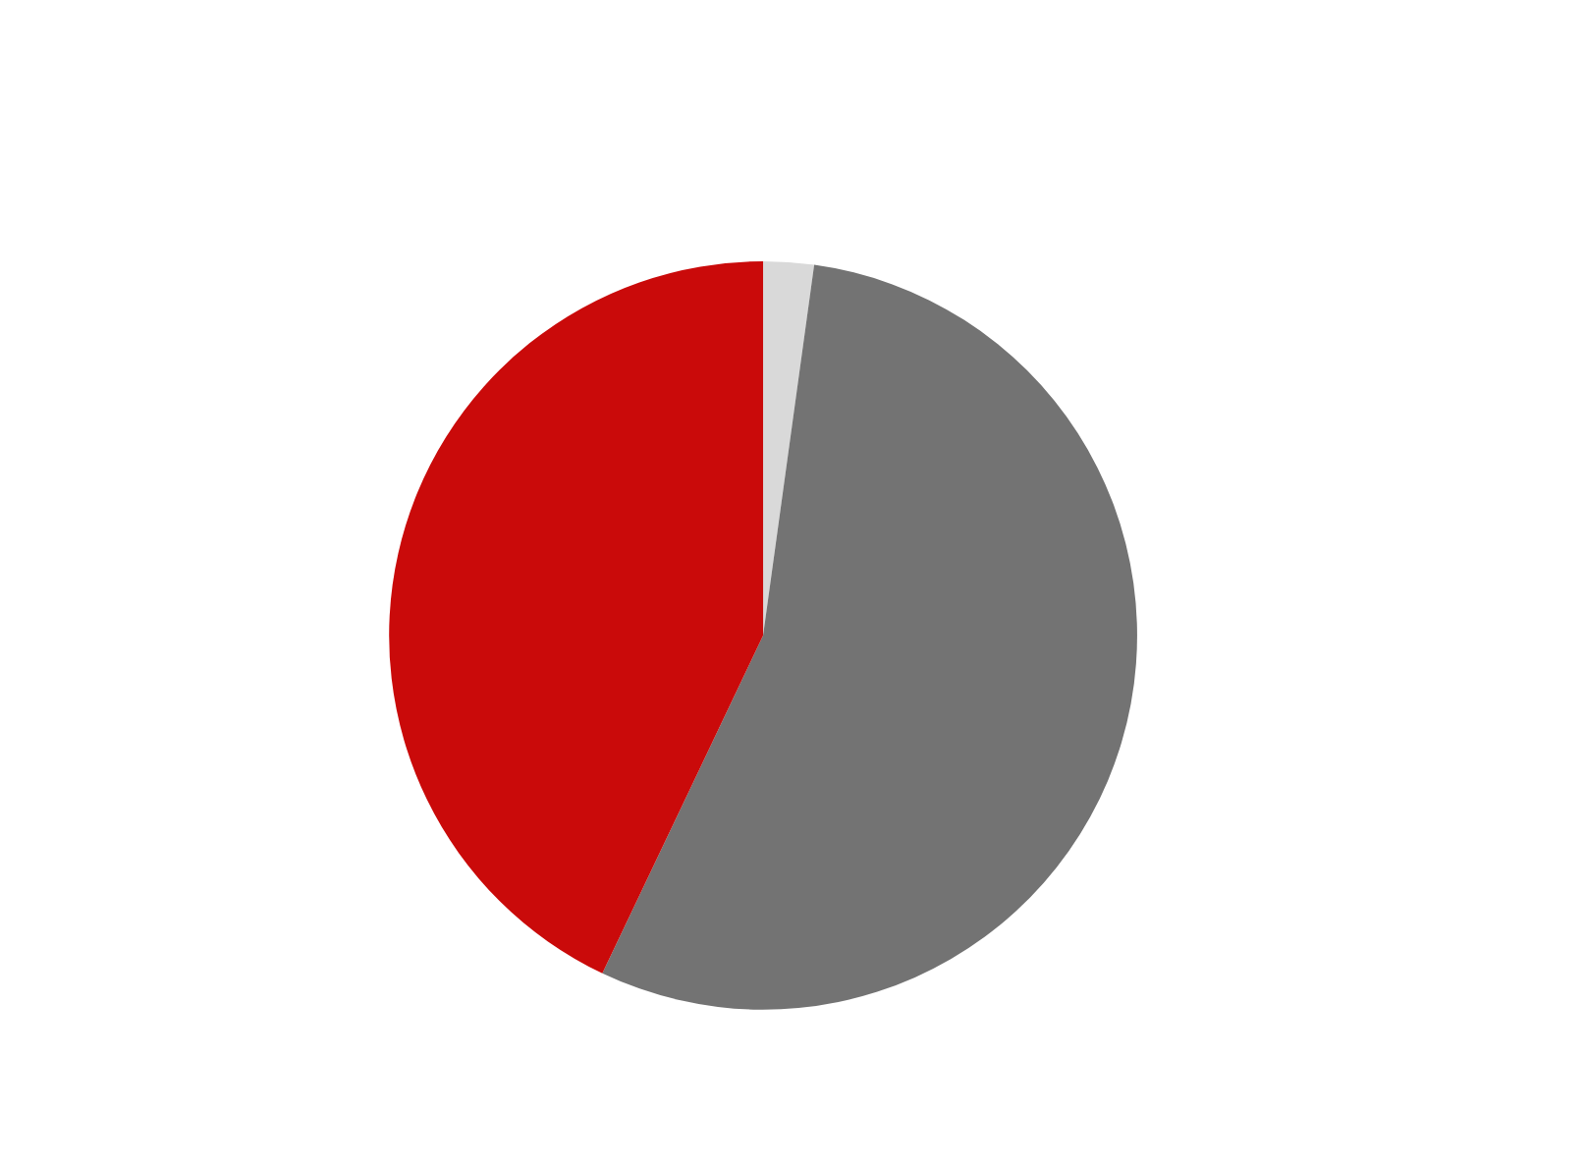
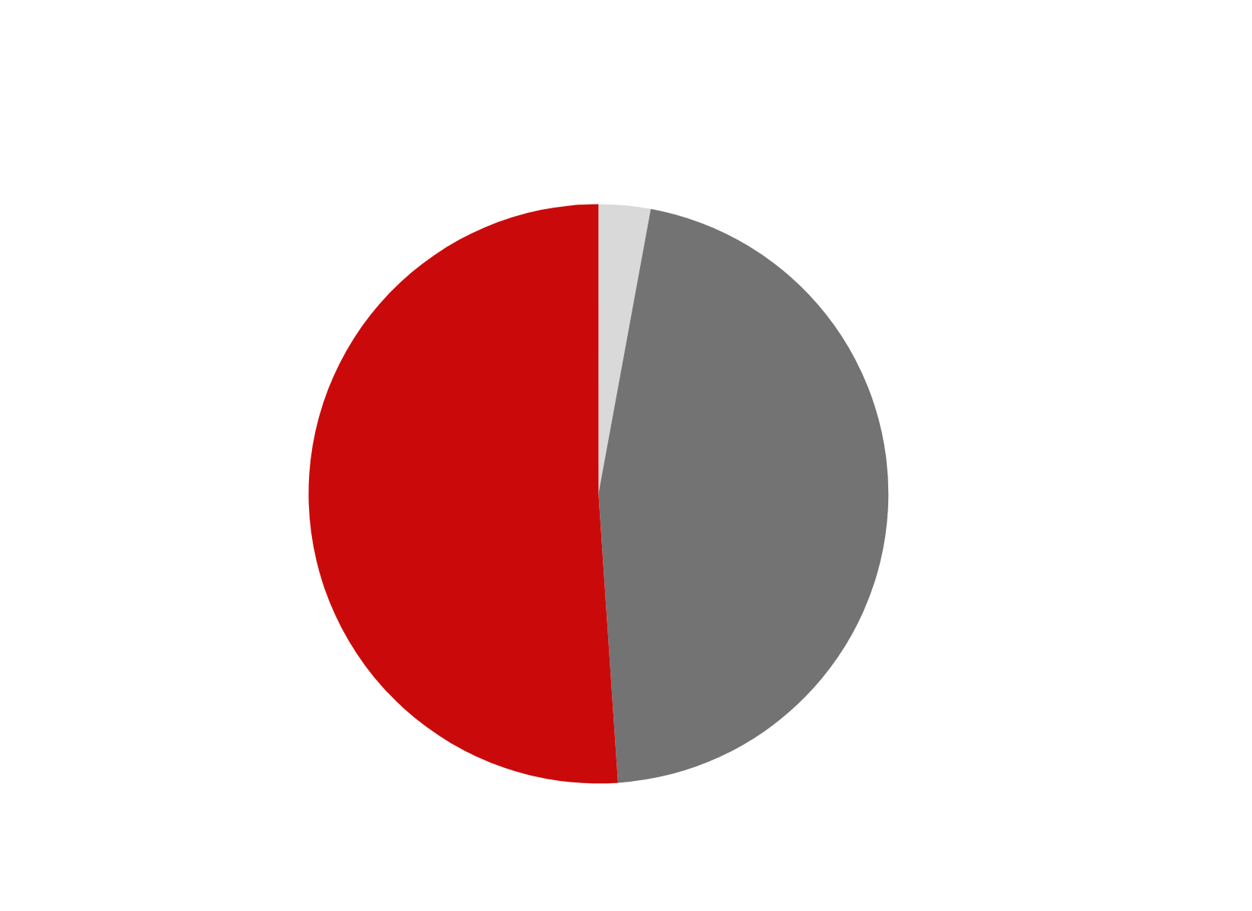
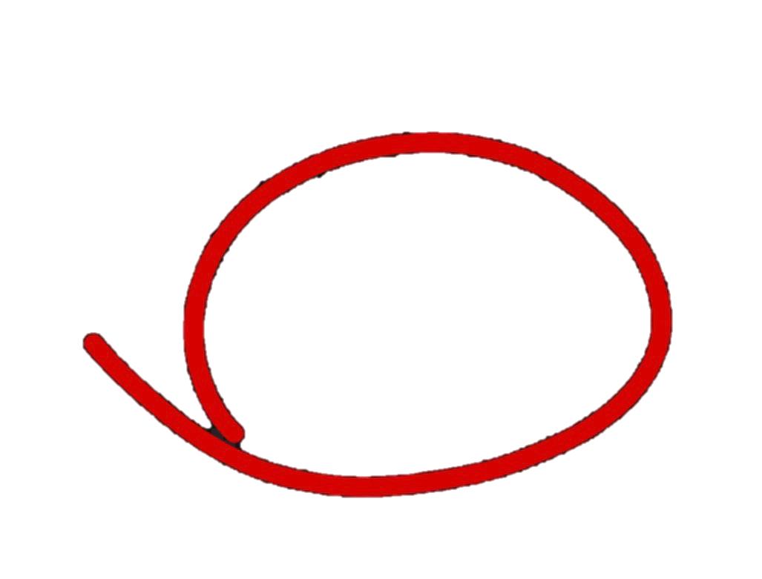
Vision
Smoker
Non Smoker
There is NO risk for smokers to develop Low Vision

Slide 7

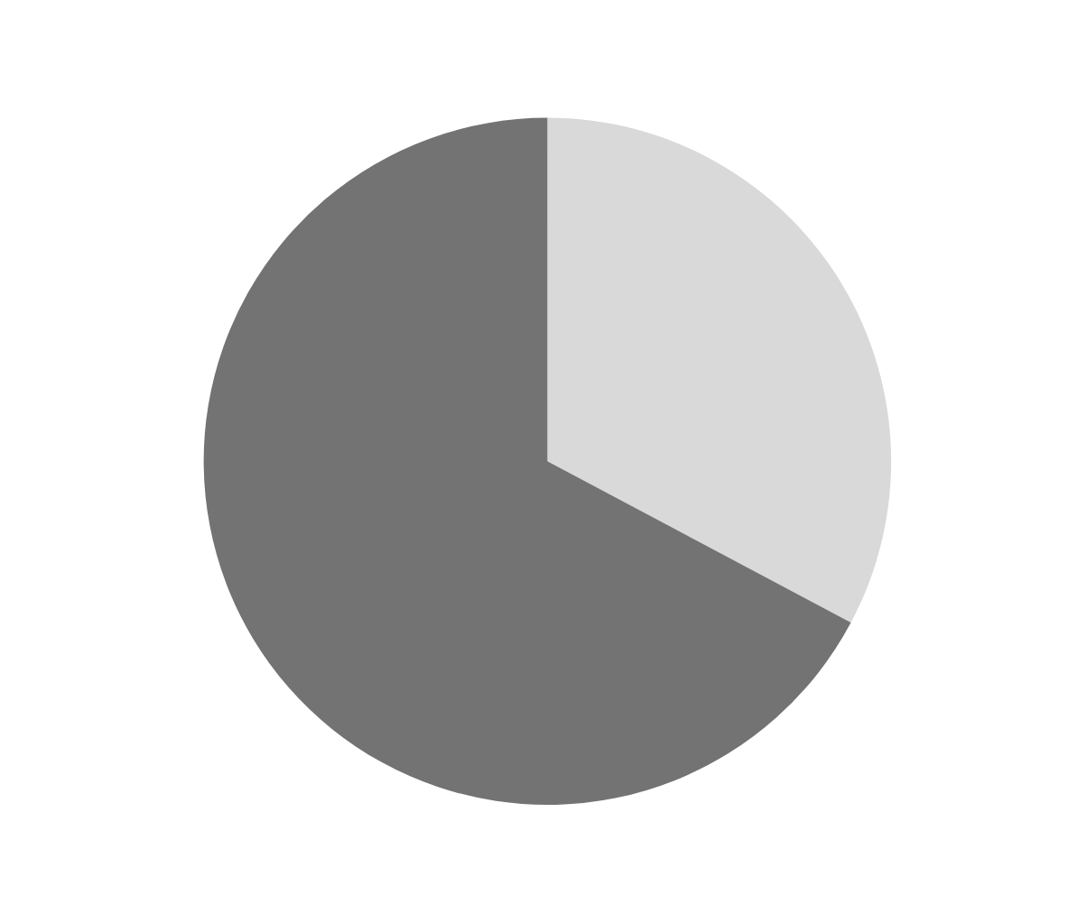
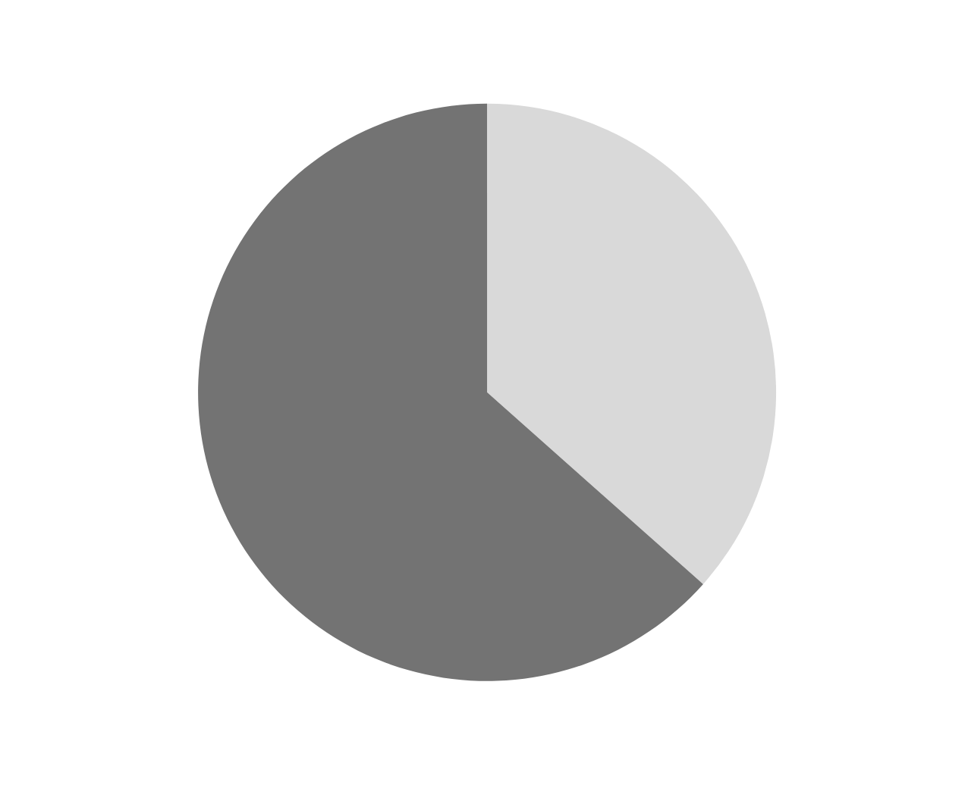
Hearing
Smokers have around 4% risk for partial hearing defect
Smoker
Non Smoker

Slide 8


Liver Function
Smoker
Normal liver profile
Normal liver profile
69.55 %
86.58 %
Unclassified pattern
11.07 %
Unclassified pattern
24.23 %
15.6%
High Risk For Smoker
Severe liver or biliary disease
Severe liver or biliary disease
4.02 %
1.58 %
Alcohol-related liver disease
Alcohol-related liver disease
2.20 %
0.77 %

Slide 9
Liver Function
Non Smoker
Normal liver profile
Normal liver profile
69.55 %
86.58 %
Unclassified pattern
11.07 %
Unclassified pattern
24.23 %
15.6%
High Risk For Smoker
Severe liver or biliary disease
Severe liver or biliary disease
4.02 %
1.58 %
Alcohol-related liver disease
Alcohol-related liver disease
2.20 %
0.77 %

Slide 10
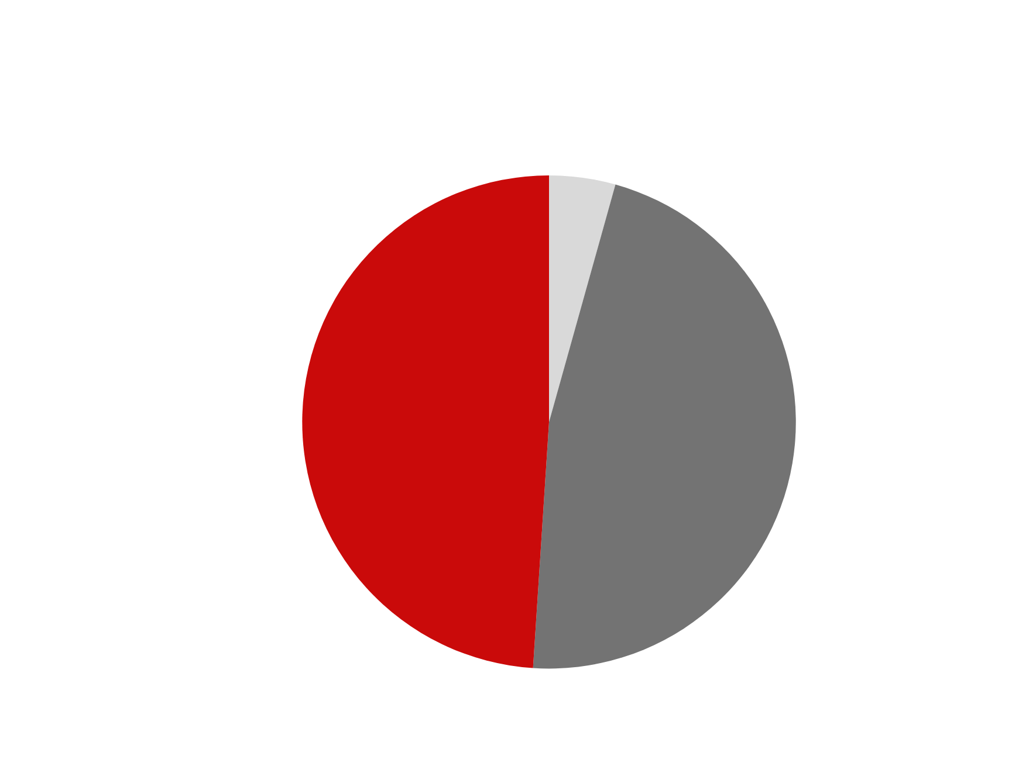
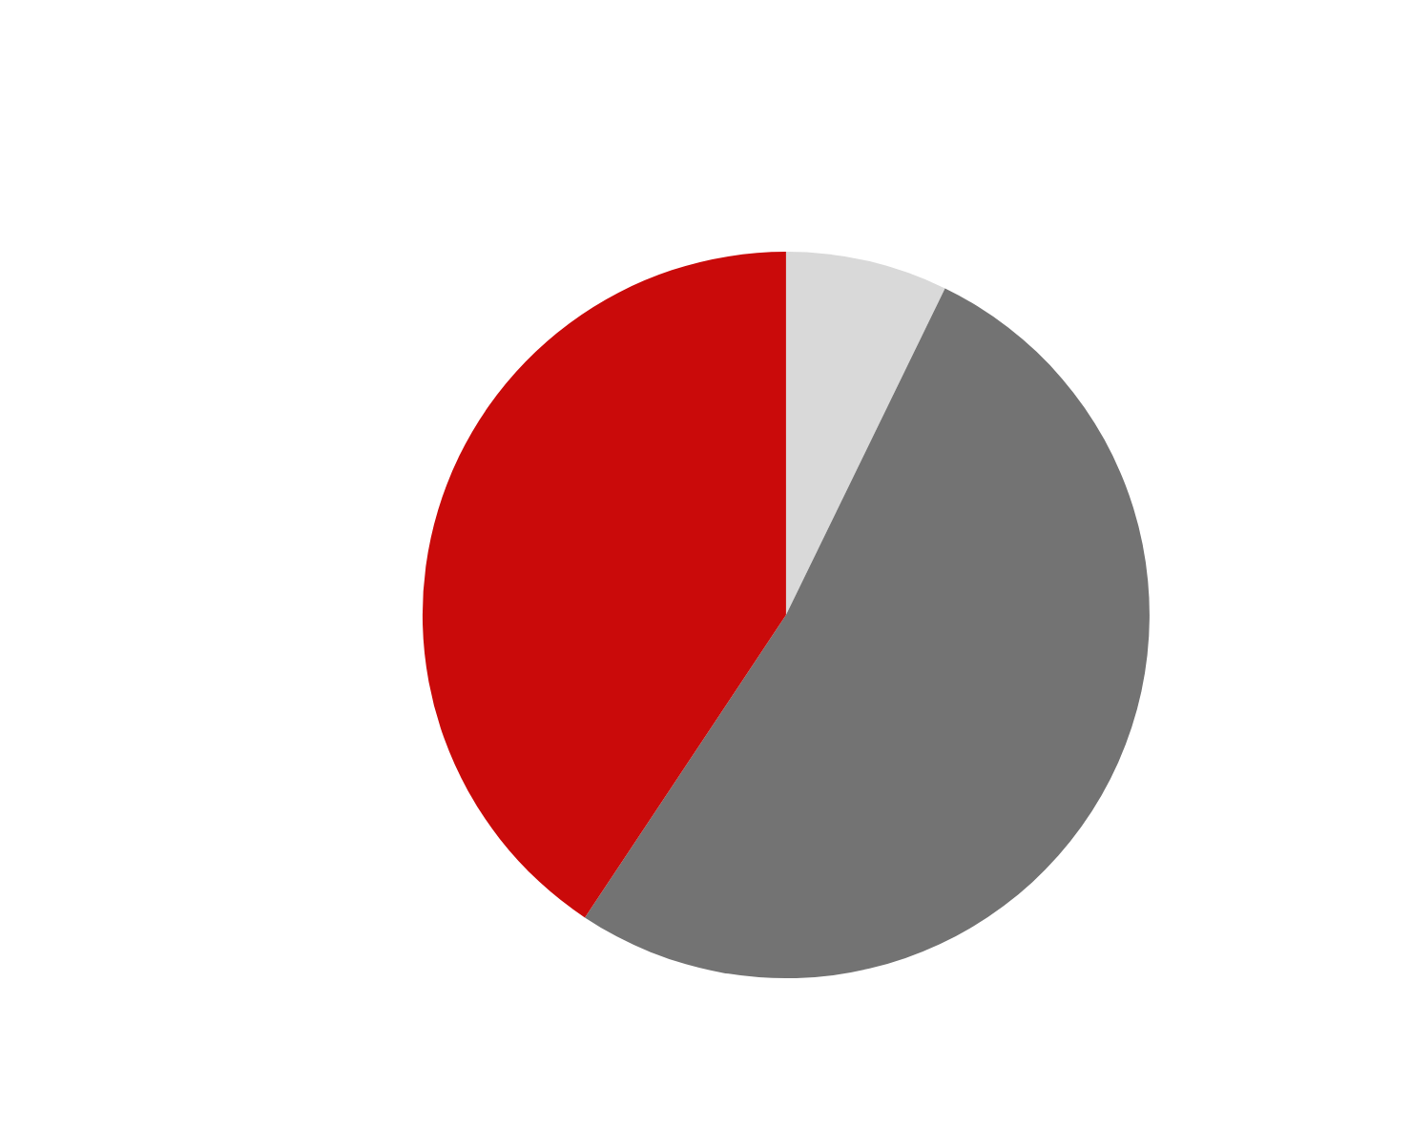
Hypertension
Smoker
Non Smoker
There is 8.3% risk for smokers to develop Hypertension

Slide 11
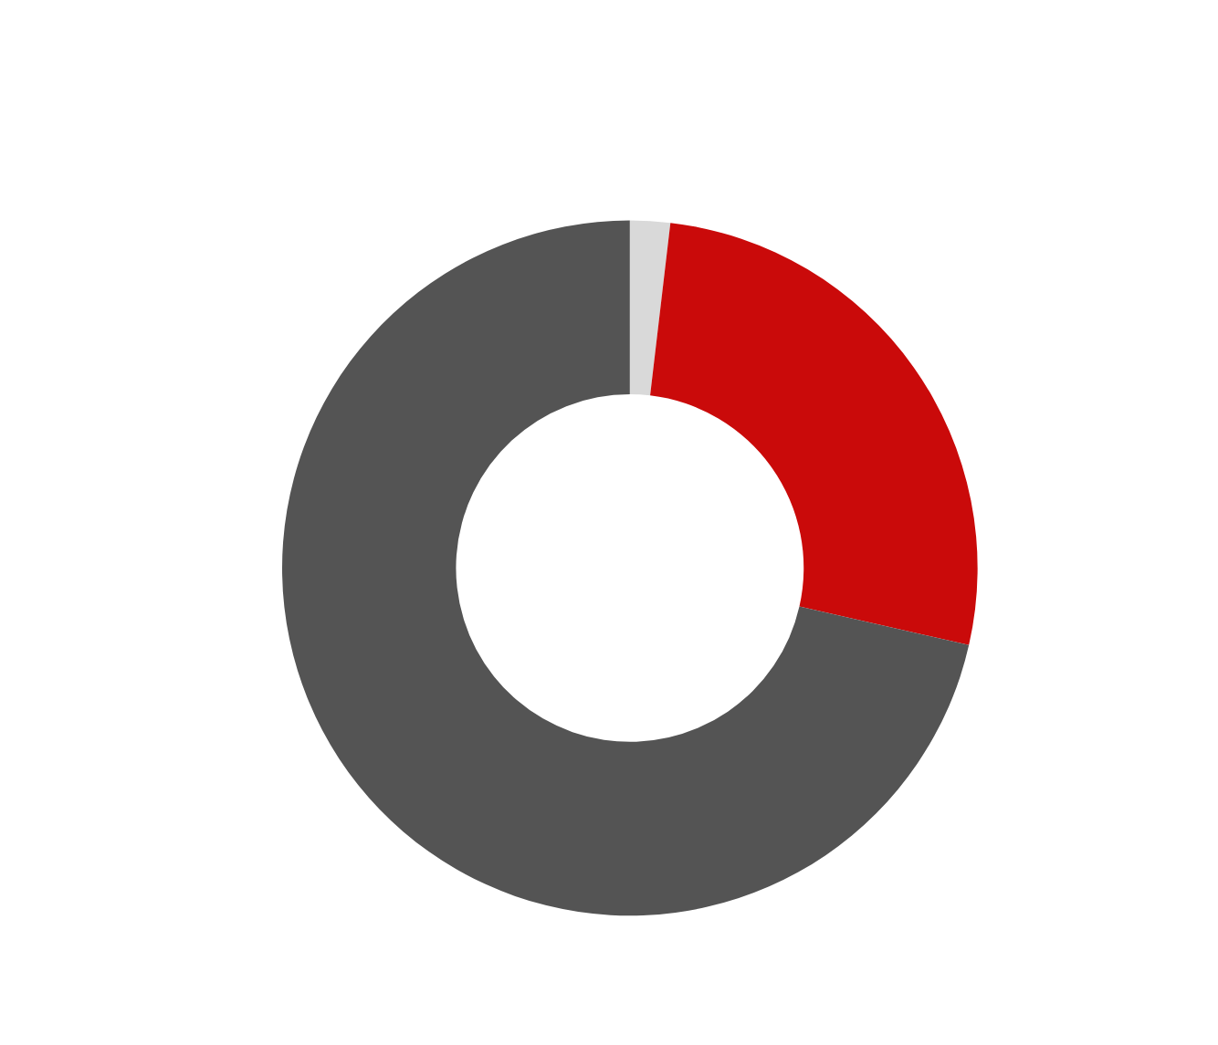
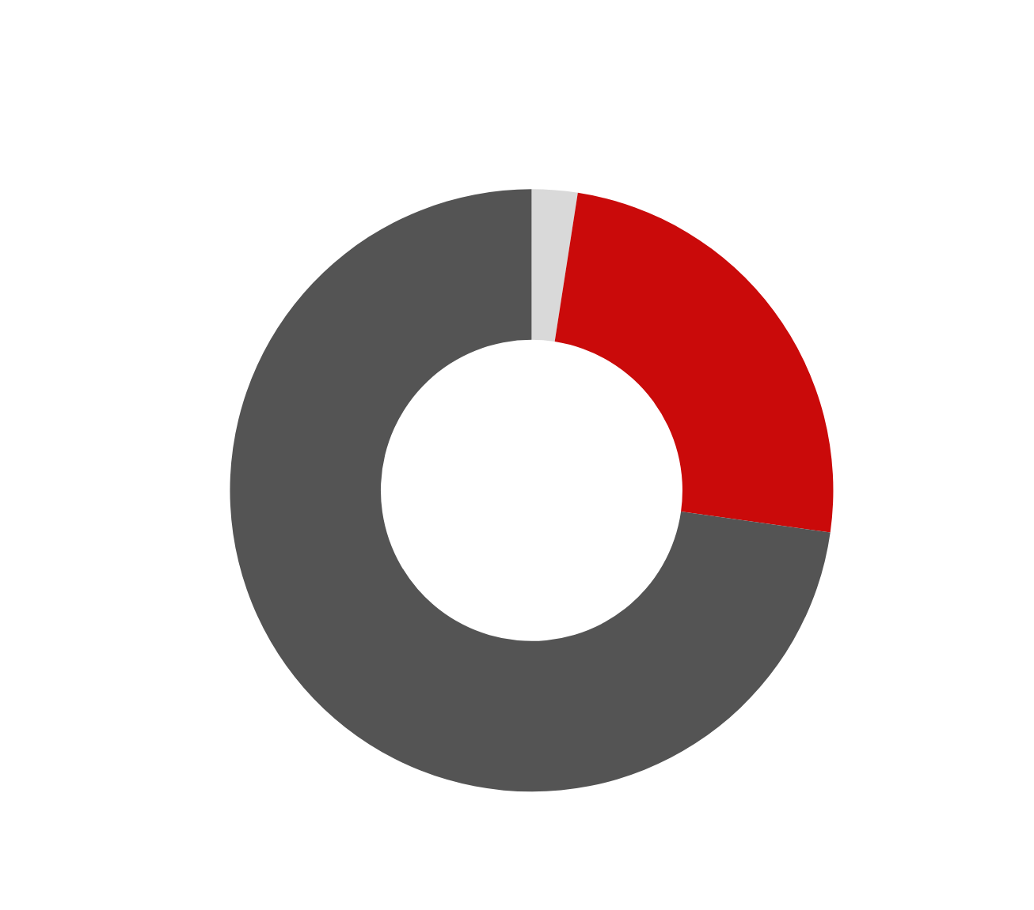
Cardiovascular
Smoker
Non Smoker
There is high risk for smokers to develop Cardiovascular according to cholesterol and hypertension

Slide 12
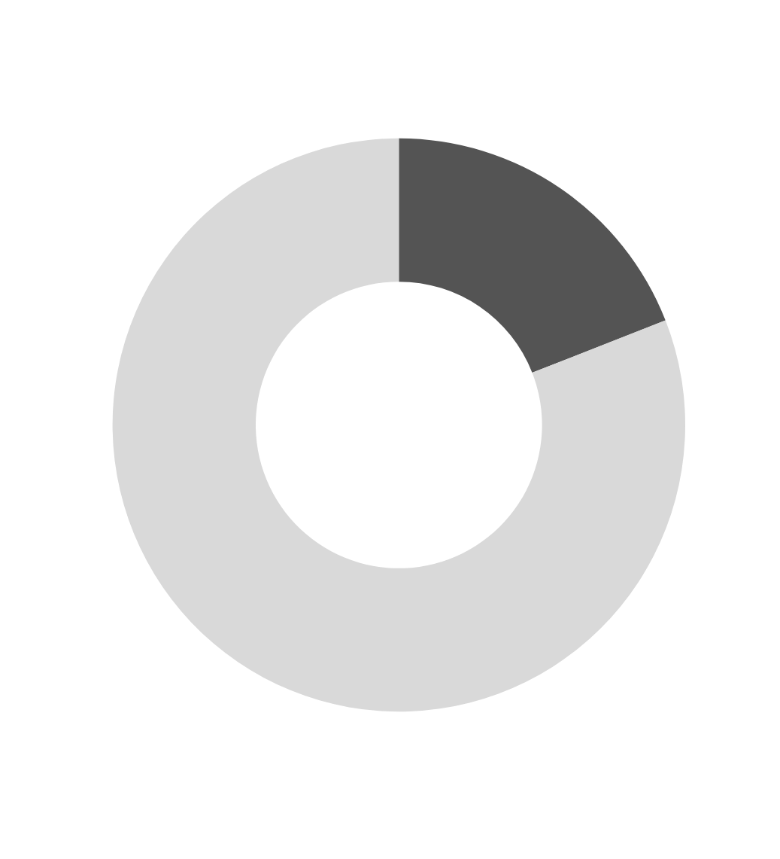

Diabetes
There is 4.3% risk for smokers to develop Diabetes

Slide 13
Diabetes
There is 4.3% risk for smokers to develop Diabetes

Slide 14

STOP SMOKING

Slide 15
Thank You

